Slide 1
Test Session Managemet
Smarter Balanced Assessment
Quick Guide
030116
1
Notes:
Welcome to the California Assessment of Student Performance and Progress also known as CAASPP, Smarter Balanced Teacher Training sponsored by the Student Testing Branch.
This training must be completed by all teachers that will be administering a Smarter Balanced Summative Assessment this year. It will help participants understand the components of the assessments, how to access and administer the assessments, and the importance of the test security measures to ensure the tests are administering according to state guidelines.
The information covered in the presentation must also be supplemented with school-specific information that will be provided by the school site testing coordinator. Your test coordinator must inform you how the school plans to inform parents about the upcoming state assessments, the school’s testing schedules, procedures for handling ear phones and student data, as well as procedures for handling secure documents such as scratch paper.
After completing this training, all teachers will need to complete the Learning Zone assessment which is accessible from the My Assessment tab in the Learning Zone. After successfully completing this training, print your certificate. You will need to provide a copy of the certificate to the school’s test coordinator as soon as the training and assessment are completed.

Slide 2
Materials Needed
Students Logon Credentials
Directions For Administration (DFAs)
Earbuds
Student Roster of students to be tested
Scratch paper for students
Pencils
Required test security signs
Notes:
In preparation for a test session, Test Administrators will want to have the following materials ready and available:
Students Log0n Credentials
Directions For Administration (DFAs)
This is the document that Test Administrators will use as their script during the administration of a test session. Test Administrators must pay attention to the sections titled “Say.” Must read everything as written in the “Say” boxes.
Earbuds
Student Roster of students to be tested
Scratch paper for students
Pencils
Required test security signs

Slide 3
Student Logon Information
Distribution of Students Logon Credentials
Test Administrators need to provide students with the student’s Statewide Student Identifier (SSID), First Name, and Session ID for logon
Follow guidelines set forth by site CAASPP coordinator
May be used year round
May be provided on a card or piece of paper
Session ID
Test Administrators write Session ID on the board or where students can see it
Test Administrators write Session ID on a separate piece of paper
Maintaining Logon Credentials Secure
Do not let students take logon credential cards outside the room
Collect and account for ALL students Logon credentials cards before students exit the room
Important: Student personal information is secure and must be collected and securely stored at the end of a test session, then securely destroyed at the end of the test administration.
Notes:
With regards to the student logon information, Test Administrators are to consider the following:
Distribution of Students Log on Credentials
Test Administrators need to provide students with the student’s Statewide Student Identifier (SSID), First Name, and Session ID for logon
Test Administrators need to follow the guidelines set forth by site CAASPP coordinator in regards to the management of the student logon information
May be used year round
May be provided on a card or piece of paper
Session ID
Test Administrators write Session ID on the board or where students can see it
Test Administrators write Session ID on separate piece of paper in order to refer to it at a later time, if so needed.
Maintaining Logon Credentials Secure
Do not let students take logon credential cards outside the room
Collect and account for ALL students log on credential cards before students exit the room
It is also very important for Test Administrators to note that student personal information is secure and must be collected and securely stored at the end of a test session, then securely destroyed at the end of the test administration.

Slide 4
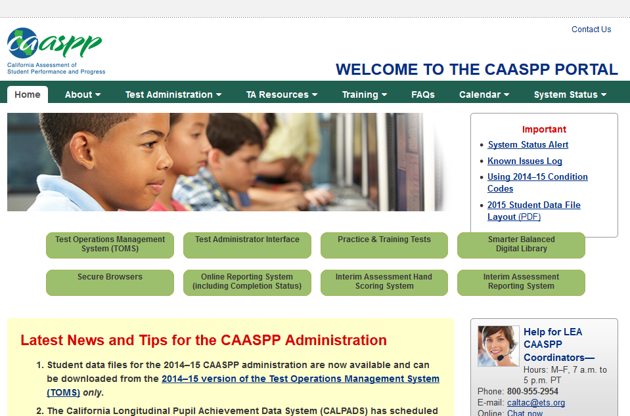
Critical Links
http://www.caaspp.org/
 Best Practice
Bookmark This Webpage
Notes:
It is imperative that all Test Administrators have the CAASPP Portal website book marked on the device that they will be using during the creation and management of a test session.

Slide 5
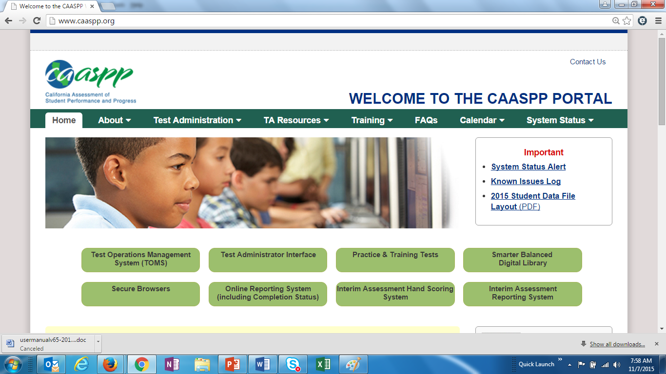
Creating a Test Session
Go to http://caaspp.org and click on Test Administrator Interface
Notes:
When a Test Administrator is ready to create a test session, they will begin by selecting the “Test Administrator Interface” button at the CAASPP Portal website.

Slide 6
Creating a Test Session
Log onto the TA Interface using your TOMS sign in credentials.
Creating a Test Session
1
Notes:
Once at the TA Interface logon screen, the Test Administrator creating the test session will logon using their TOMS sign in credentials.

Slide 7
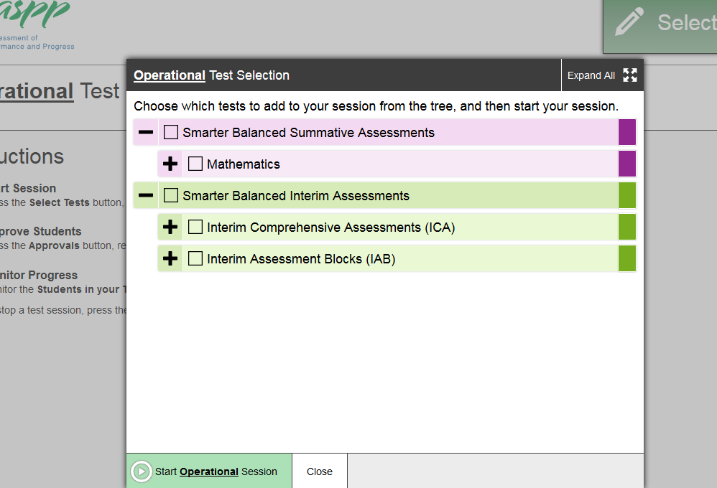
Creating a Test Session
The TA selects the test category or the grade and content area for the desired test, taking special note of weather they are intending to administer a SUMMATIVE or INTERIM assessment
Notes:
Once logged on to the TA Interface, the Test Administrator selects the test category or the grade and content area for the desired test, taking special note of the test they are intending to administer and if it is a SUMMATIVE or INTERIM assessment.

Slide 8
Creating a Test Session
The TA starts a test session which will generate a “Session ID”
Notes:
Once the Test Administrator has selected the desired tests for the test session, the Test Administrator starts the test session by clicking on the “Start Operational Session” button which will generate a unique “Session ID”.

Slide 9
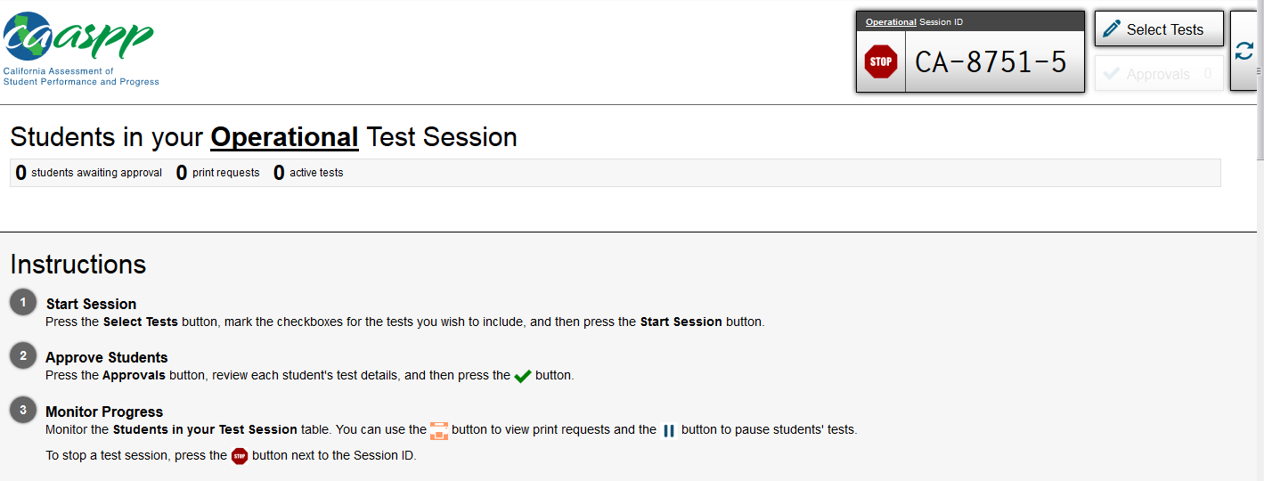
Creating a Test Session
The TA informs students of the test Session ID
Write or display clearly in a place all students can see
Session IDs are automatically generated upon selecting the [Start Session] button
1
Notes:
Upon starting the test session and generating a session ID, the Test Administrator informs students of the test Session ID by writing or displaying it clearly in a place where all students can see it.
Session IDs are automatically generated upon selecting the “Start Operational Session” button.
Test administrators must also record and save all Test Session IDs for future reference.

Slide 10
Students Logon Process
Students log on through the secure browser
Recommended:
Secure browsers are already launched on testing devices before students sit down to test
To log on, students need:
First Name (Confirmation Code): Student’s legal first name as spelled in TOMS
State-SSID: “CA” followed by a hyphen “-” and the student’s SSID
Session ID: TA-generated
i
ii
iii
Notes:
Once the Test Administrator has created a test session and has displayed the Session ID, students log on to the test session through the secure browser. It is recommended that the secure browsers are already launched on testing devices before students sit down to test. To log on, students need the following:
First Name (Confirmation Code): Student’s legal first name as spelled in TOMS
State-SSID
Session ID: Generated by the Test Administrator
To facilitate the logon process, the CAASPP coordinator will generate the labels in MiSIS that contain the student log on credentials.

Slide 11
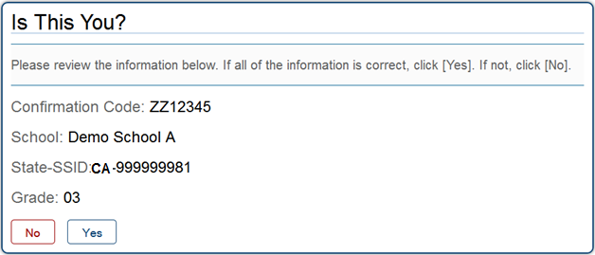
Students Logon Process
Students verify their identity
After logging on, students will see the “Is This You?” screen
Students should select [Yes] to continue
1
Notes:
Once the student has logged on to the test session, students will verify their identity as follows:
After logging on, students will see the “Is This You?” screen
Students should select [Yes] to continue

Slide 12
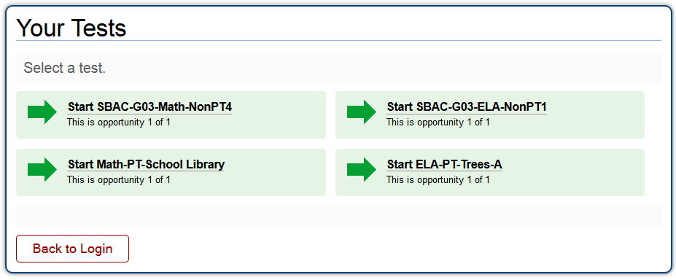
Students Logon Process
Students select the test
All grade-level tests that the student is eligible to take are displayed
Only the tests that the TA selected for the test session and those that have not been completed are selectable by students
1
Notes:
Upon verifying their identity, students will select the test intended to be taken as instructed by their Test Administrator. Note that:
All grade-level tests that the student is eligible to take are displayed
Only the tests that the Test Administrator selected for the test session and those that have not been completed are selectable by students

Slide 13
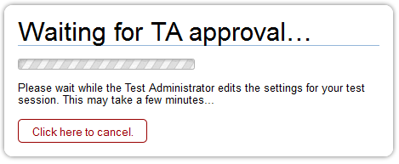
Students Logon Process
Upon selecting a test, students will wait for TA approval
Notes:
Upon selecting a test, students will wait for the Test Administrators approval.

Slide 14
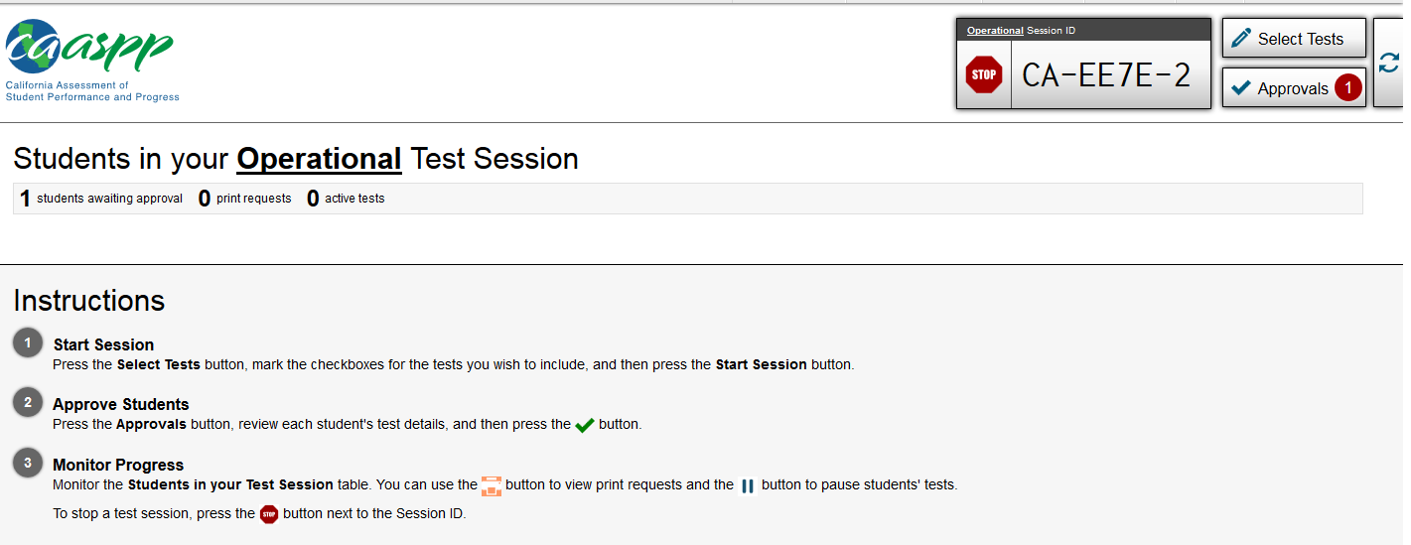
Approving Students to Start Testing
As students select tests, the TA will see approvals populate in the Approvals queue of the TA Interface
1
Notes:
As students select tests, the Test Administrator will see approvals begin to populate in the Approvals queue of the TA Interface.

Slide 15
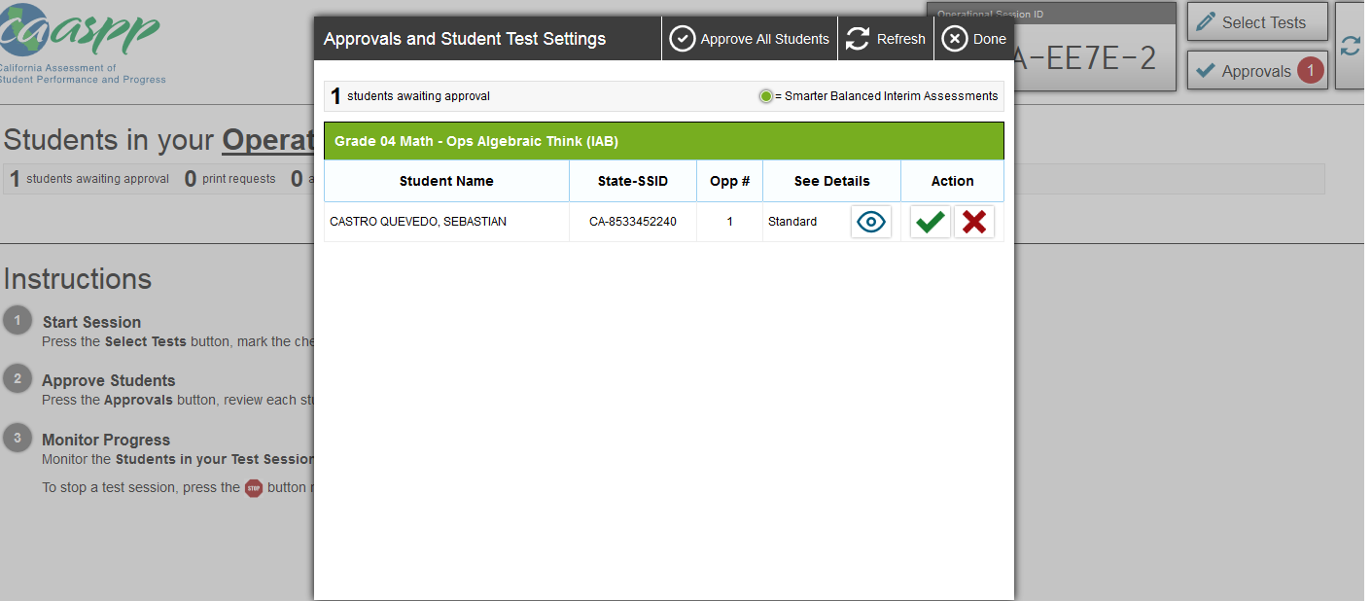
Approving Students to Start Testing
The TA selects the [Approvals (#)] button to access the Approvals and Student Test Settings screen
1
Notes:
The Test Administrator selects the “Approvals (#)” button to access the Approvals and Student Test Settings screen.

Slide 16
Approving Students to Start Testing
The TA verifies the student has selected the appropriate test
The TA reviews the students’ test settings by selecting [See Details] button next to each student
1
2
Notes:
As the names of the students begin to appear:
The Test Administrator verifies the student has selected the appropriate test
The Test Administrator reviews the students’ test settings by selecting the “See Details” button next to each student’s name

Slide 17
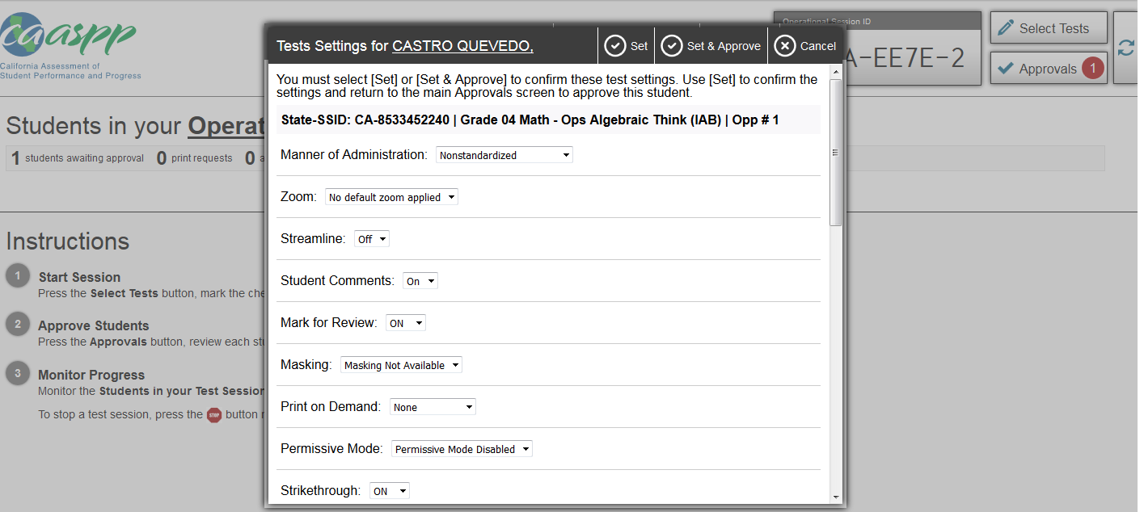
Approving Students to Start Testing
The TA reviews the students’ test settings for each student that they know should have Designated Supports or Accommodations
The TA selects [Set] to confirm the current test settings and return to the list of students awaiting approval OR
The TA selects [Set & Approve] to establish the existing settings and approve the student for testing
2
3
1
Notes:
Prior to approving a student to begin a test:
The Test Administrator reviews the students’ test settings for each student that they know should have Designated Supports or Accommodations
The Test Administrator selects “Set” to confirm the current test settings and return to the list of students awaiting approval OR
The Test Administrator selects “Set & Approve” to establish the existing settings and approve the student for testing

Slide 18
Approving Students to Start Testing
Once the TA verifies the student has selected the appropriate test and reviews the students’ test settings, the TA can approve the student to begin the test
If a student’s test settings are incorrect, TA should deny the student, contact the CAASPP Coordinator to correct the test settings in TOMS and test the student on another day
1
2
Notes:
Once the Test Administrator has reviewed the students test settings:
The Test Administrator can approve the student to begin the test
If a student’s test settings are incorrect, the Test Administrator should deny the student, contact the CAASPP Coordinator to correct the test settings in TOMS and test the student on another day

Slide 19
Denying Students Entry Into Test Session
Student is not supposed to enter session
Student selected the wrong test
If administering Performance Task, student has not participated in classroom activity
Student’s grade level is incorrect
Student’s required Designated Supports and Accommodations are missing or incorrect
Notes:
Denying a student to begin a test session is to be considered under the following circumstances:
If student selected the wrong test
If administering the Performance Task and the student has not participated in the classroom activity
If student’s grade level is incorrect
If student’s required Designated Supports and/or Accommodations are missing or incorrect

Slide 20
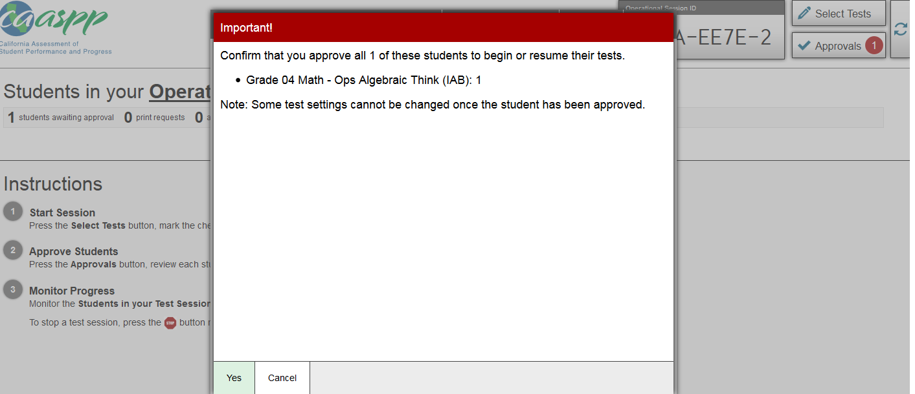
Approving Students to Start Testing
Once the TA approves the student to begin the test, they will receive an important notification asking the TA to confirm that they want to approve the student to take the selected test
If the TA is certain that they want to approve the student to take the selected test, they are to confirm their approval
1
2
Notes:
Once the Test Administrator approves the student to begin the test, they will receive an important notification asking the Test Administrator to confirm that they want to approve the student to take the selected test. If the Test Administrator is certain that they want to approve the student to take the selected test, they are to confirm their approval.

Slide 21
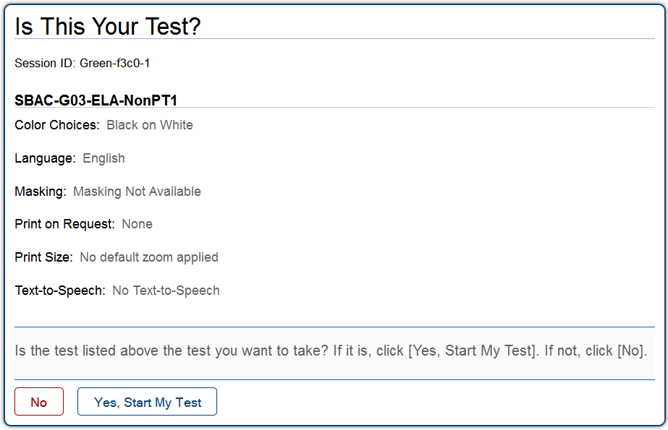
Approving Students to Start Testing
After the TA has approved a student for testing, the student will verify the test information and settings
The student will select [Yes, Start My Test] to begin testing or [No] if their settings are incorrect
1
2
Notes:
Once the student has been approved to begin the test, the student will verify the test information and settings and the student will select “Yes, Start My Test” to begin testing or “No” if their settings are incorrect.

Slide 22
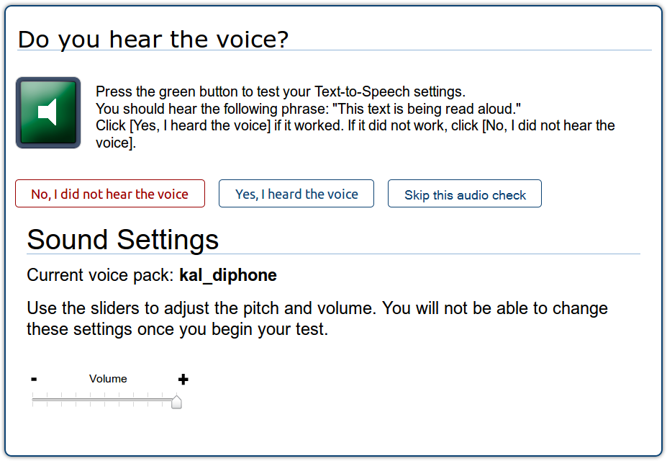
Approving Students to Start Testing
If a student has a text-to-speech accommodation he or she will verify the audio checks through their earbuds
If a student is taking a test with ELA listening items, he or she will verify the audio checks through their earbuds
1
2
Test with listening items audio check
Text-to-speech audio check
Notes:
If a student has a text-to-speech Accommodation, he or she will verify the audio checks through their earbuds.
If a student is taking a test with ELA listening items, he or she will verify the audio checks through their earbuds.

Slide 23
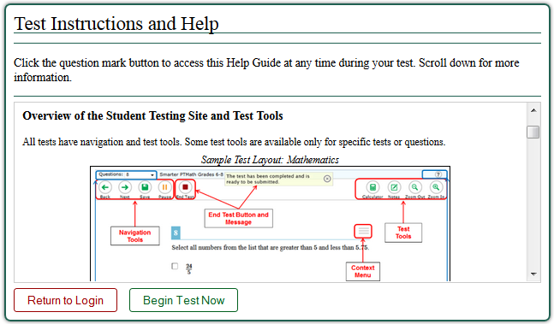
Approving Students to Start Testing
Students will see the Test Instructions and Help page before they begin testing
Students will select [Begin Test Now] to begin testing
1
2
Notes:
Before the student begins testing they will see the Test Instructions and Help page. Test Administrators may have students review the test instructions at this time.
After reviewing the test instructions, students will select “Begin Test Now” to begin testing.

Slide 24
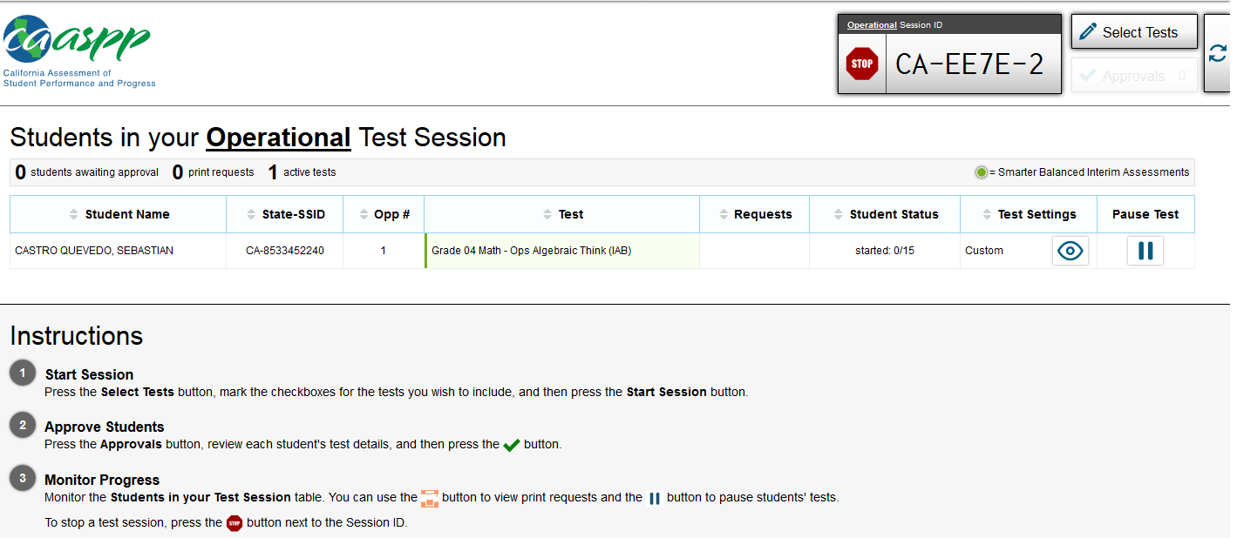
Monitoring Student Progress
TAs can monitor student testing through the Students in Your Operational Test Session table on the TA Interface
Displays students who have logged in and been approved for testing
1
2
Notes:
Once students have begun taking their test, Test Administrators can monitor testing through the Students in Your Operational Test Session table on the TA Interface which displays students who have logged on and have been approved for testing.

Slide 25
Pausing Tests
TAs may pause an individual student’s test in the Students in Your Test Session table. This will not affect other students’ tests
1
Notes:
Test Administrators may pause an individual student’s test in the Students in Your Test Session table. This will not affect other students’ testing.

Slide 26
General Pause Rules
If there is a technical issue (e.g., power outage or network failure), students will be logged out and the tests will automatically be paused
If a test is paused, the student must log in again to resume testing
Notes:
General pause rules during a test session include:
If there is a technical issue (for example, power outage or network failure), students will be logged out and the tests will automatically be paused.
If a test is paused, the student must log on again to resume testing.

Slide 27
Pause Rules: Computer Adaptive Test
If a Non-Performance Task is paused for more than 20 minutes, the student is:
Presented with the test page containing the test item he or she was last working on (if the page contains at least 1 unanswered item) OR
Presented with the next test page (if all items on the previous test page were answered)
Not permitted to review or change any test items on previous test pages
If a Non-Performance Task is paused for less than 20 minutes, the student is:
Presented with the test item or passage he or she was working on when the test was paused
Permitted to answer previously shown items within a segment
Notes:
Pause rules for the Computer Adaptive (CAT-Non-PT) include:
If a Non-Performance Task is paused for more than 20 minutes, the student is:
Presented with the test page containing the test item he or she was last working on (if the page contains at least 1 unanswered item) OR
Presented with the next test page (if all items on the previous test page were answered)
Not permitted to review or change any test items on previous test pages
If a Non-Performance Task is paused for less than 20 minutes, the student is:
Presented with the test item or passage he or she was working on when the test was paused
Permitted to answer previously shown items within a segment

Slide 28
Pause Rules: Performance Task
There are no pause rules for Performance Tasks (PT)
Even if a Performance Task is paused for more than 20 minutes, the student can return to the current section and continue
ELA PTs are divided into two parts
After a student completes the first part, he or she cannot return to it.
Notes:
Pause rules for the Performance Task (PT) include:
There are no pause rules for Performance Tasks
Even if a Performance Task is paused for more than 20 minutes, the student can return to the current section and continue
ELA PTs are divided into two parts
After a student completes the first part, he or she cannot return to it.

Slide 29
Test Timeout Due to Inactivity
As a security measure, students are automatically logged out of the test after 30 minutes of inactivity
Activity means:
Selecting an answer
Using a navigation option in the test (e.g., selecting [Next] or [Back], using the Questions drop-down list)
Note: Moving the mouse or selecting an empty space on the screen is not considered activity
Before the system logs out, a warning message will be displayed
Notes:
In regards to Test Timeout Due to Inactivity, Test Administrators should note the following:
As a security measure, students are automatically logged out of the test after 30 minutes of inactivity
Activity means:
Selecting an answer
Using a navigation option in the test (e.g., selecting [Next] or [Back], using the Questions drop-down list)
Moving the mouse or selecting an empty space on the screen is not considered activity
Before the system logs out, a warning message will be displayed

Slide 30
Stopping an Entire Test Session
TAs can stop a test session (and therefore pause tests for all students in the session) by selecting the [Stop Session] button
1
Notes:
If needed, Test Administrators can stop an entire test session and therefore pause tests for all students in the session by selecting the “Stop Session” button.

Slide 31
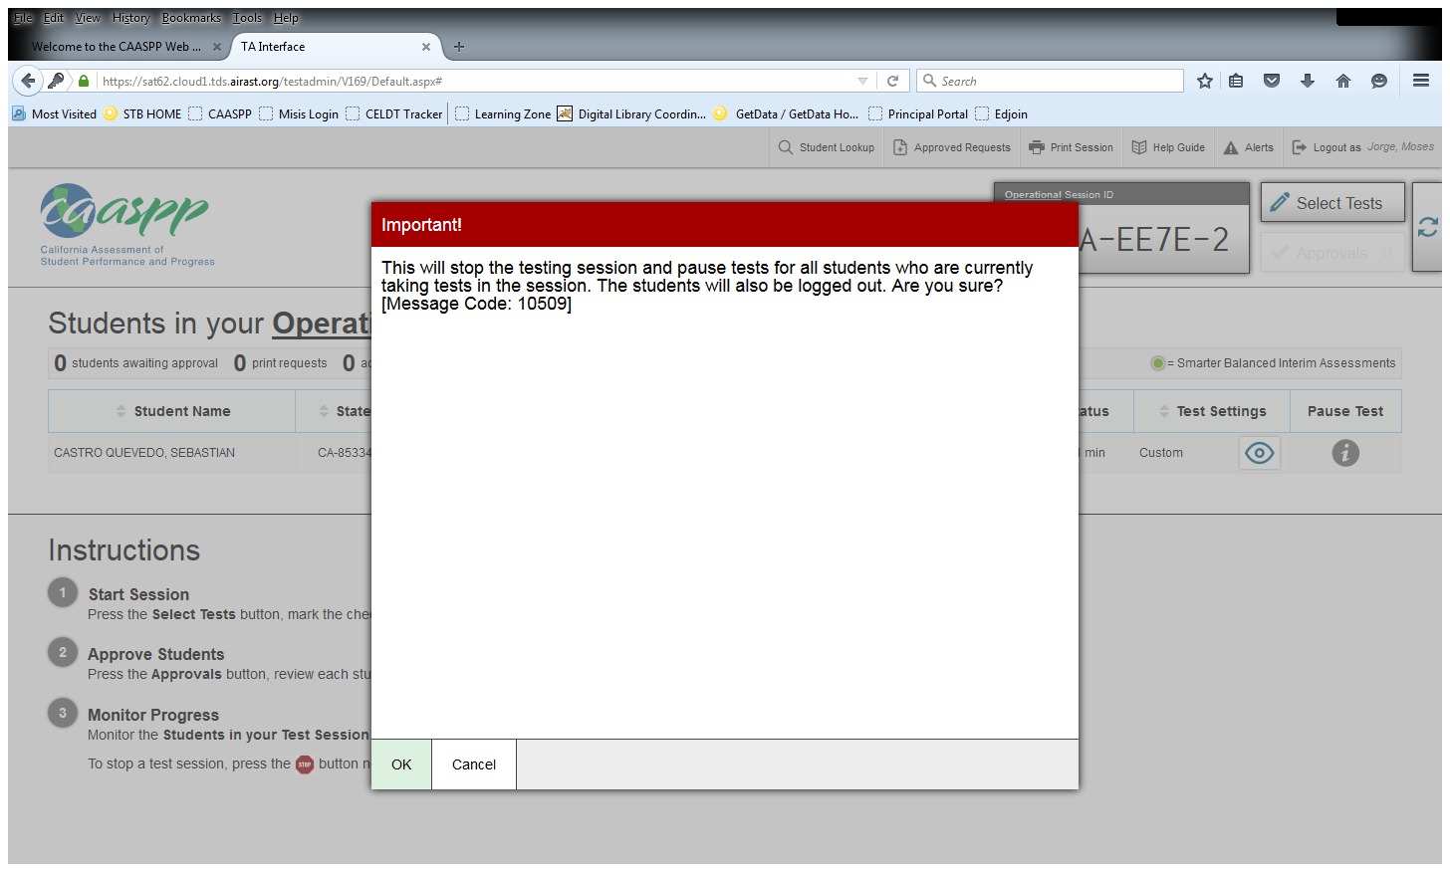
Stopping an Entire Test Session
TAs can stop a test session (and therefore pause tests for all students in the session) by selecting the [Stop Session] button. At that point, an “Important!” box will appear, requesting verification to end the session and log students out
Select [OK] to continue or [Cancel] to keep the test session open
1
2
Notes:
Once Test Administrators have chosen to stop the entire session, at that point, an “Important!” box will appear, requesting verification to end the session and log students out. At that point, the Test Administrator is to select “OK” to continue or “Cancel” to keep the test session open.

Slide 32
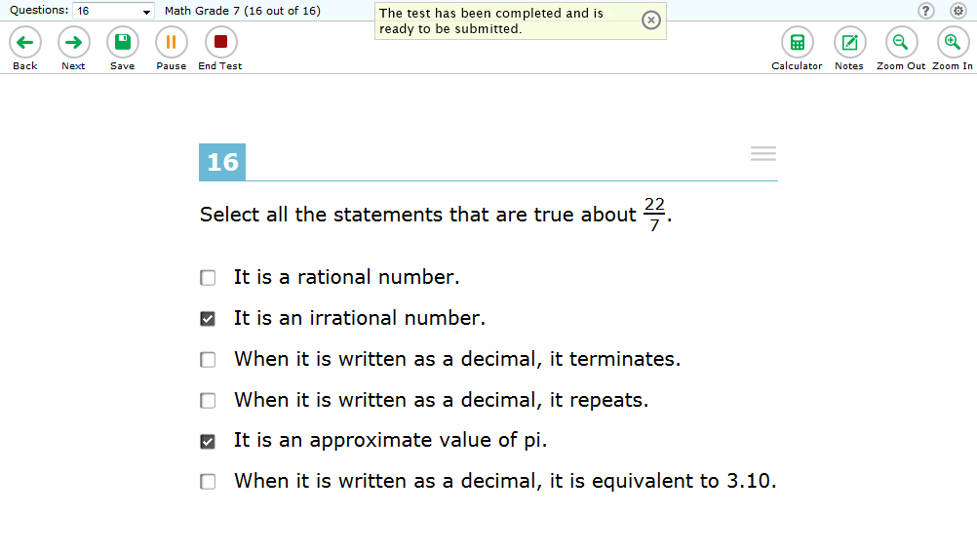
Reaching the End of the Test
After students answer the last item on the test, the [End Test] button will appear in the upper-left corner of the screen. At that point, with the approval of the TA, student is to select the [End Test] button
1
Notes:
After students answer the last item on the test, the “End Test” button will appear in the upper-left corner of the screen. At that point, with the approval of the Test Administrator, the student is to select the “End Test” button.

Slide 33
Reaching the End of the Test
Upon selecting the [End Test] button, an “Attention” message will appear
Students will select [Yes] to proceed with reviewing answers and submitting the test
1
2
Notes:
Upon selecting the “End Test” button, an “Attention” message will appear and students will select “Yes” to proceed with reviewing answers and submitting the test.

Slide 34
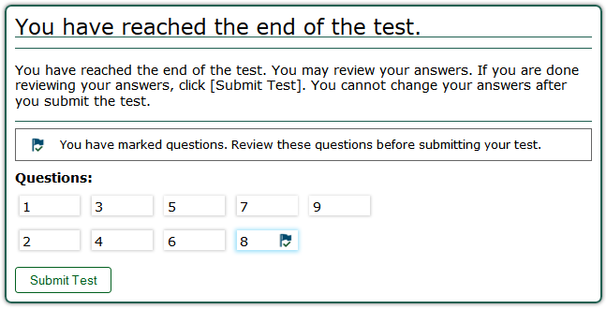
Reaching the End of the Test
Students may review answers before submitting a test
To review a specific question, the student can select the questions number
1
2
Notes:
When reviewing their test questions:
Students may review answers before submitting a test.
To review a specific question, the student can select the question number.

Slide 35
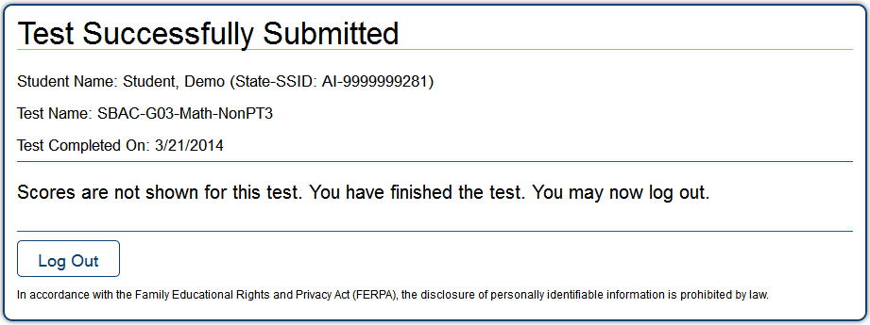
Reaching the End of the Test
When a student is ready to submit the test, he or she will receive a confirmation screen
At this point, the student is ready to select the “Log Out” button
1
2
Notes:
After reviewing their test questions:
When a student is ready to submit the test, he or she will receive a confirmation screen.
At this point, the student is ready to select the “Log Out” button.

Slide 36
Grade 11 Only: Early Assessment Program
The Early Assessment Program (EAP) uses the high school Smarter Balanced Summative Assessments for ELA and Mathematics
Students taking the Smarter Balanced Summative Assessments in Grade 11 may choose to release their test scores to the California State University (CSU) and participating California Community Colleges (CCC) at the end of the ELA and Mathematics computer-adaptive tests (CAT)
EAP may earn students an exemption from the CSU and participating CCC English and/or mathematics placement tests that are required for entering freshmen
To authorize the release of their results, students should mark the circle that indicates their understanding that their CAASPP/EAP results will be shared directly with the CSU and/or the CCC. Students who choose not to release their results to the CSU and CCC will need to provide those results upon request at a later date
Notes:
The Early Assessment Program (EAP) is a joint program of the CDE, California State University (CSU), and the California Community Colleges (CCC). The EAP provides students with an early indicator of their college readiness in English and mathematics prior to starting the senior year. In addition, EAP may earn students an exemption from the CSU and participating CCC English and/or mathematics placement tests that are required for entering freshmen.
Students taking the grade eleven CAASPP ELA and mathematics assessments will automatically be participating in the EAP. At the end of the Smarter Balanced grade eleven English Language Arts and mathematics tests, students will be asked to release their results to the CSU and CCCs. To authorize the release of their results, students should mark the circle that indicates their understanding that their CAASPP/EAP results will be shared directly with the CSU and/or the CCC. Students who choose not to release their results to the CSU and CCC will need to provide those results upon request at a later date

Slide 37
Test Expiration Rules
A student’s Non-Performance Task test remains active until the student completes and submits the test or 45 calendar days after the student has begun the Non-Performance Task.
A student’s Performance Task remains active until the student completes and submits the test or for 10 calendar days after the student has begun the Performance Task.
Notes:
There are test expiration rules that apply to both the Non-Performance Task and the Performance Task. These rules include:
A student’s Non-Performance Task test remains active until the student completes and submits the test or 45 calendar days after the student has begun the Non-Performance Task.
A student’s Performance Task remains active until the student completes and submits the test or for 10 calendar days after the student has begun the Performance Task.

Slide 38
Classroom Activity Administration Guidelines
Purpose: To provide students with important context, concepts, and key terms prior to taking the Performance Task
All students will have a Classroom Activity before they take and complete Performance Task
The Classroom Activity may be administered in a classroom or any other appropriate setting
No more than a 3-day lapse between the classroom activity and the Performance Task administration
Notes:
As part of the administration of the Performance Task, students are to be afforded the opportunity to take part in a Classroom Activity. The following information pertains to the Classroom Activity:
The purpose of the Classroom Activity is to provide students with important context, concepts, and key terms prior to taking the Performance Task.
All students will have a classroom activity before they take and complete a Performance Task.
The Classroom Activity may be administered in a classroom or any other appropriate setting.
There should be no more than a 3-day lapse between the Classroom Activity and the Performance Task administration.

Slide 39
Classroom Activity Administration Guidelines (cont.)
Computers, projectors, and other technology are allowed but not required for the classroom activity
The Classroom Activity should involve the participation of all students in the instructional tasks of the lesson.
Students may take notes during the classroom activity, but the notes must be collected before proceeding to take Performance Task and may not be used by the students during the completion of the Performance Task.
Notes:
Classroom Activity information continued…
As part of the administration of the Performance Task, students are to be afforded the opportunity to take part in a related Classroom Activity. The following information pertains to the Classroom Activity:
Computers, projectors, and other technology are allowed but not required for the Classroom Activity.
The Classroom Activity should involve the participation of all students in the instructional tasks of the lesson.
Students may take notes during the classroom activity, but the notes must be collected before proceeding to take the Performance Task and may not be used by the students during the completion of the Performance Task.

Slide 40
Classroom Activity Administration Guidelines (cont.)
Designed to fit into a 30-minute window but will vary due to complexity of topic and individual student needs
The school CAASPP coordinator will download the assigned classroom activity and provide it to the Test Administrator (TA) at least 1–2 days prior to the administration of the Classroom Activity
Notes:
Classroom Activity information continued…
As part of the administration of the Performance Task, students are to be afforded the opportunity to take part in a related Classroom Activity. The following information pertains to the Classroom Activity:
The Classroom activity is designed to fit into a 30-minute window but will vary due to complexity of topic and individual student needs.
The school CAASPP coordinator will download the assigned classroom activity and provide it to the Test Administrator at least 1–2 days prior to the administration of the Classroom Activity in order for the teacher to best prepare to teach the lesson.

